Slide 1

Neural Networks
A Gentle-ish Introduction

Slide 2
Overview
Neural networks – what are they, how do they work
MNIST network details
PyTorch MNIST Example
Miscellaneous Cool Stuff

Slide 3
Intro to Neural Networks
What are they? How do they work? Why do they work?

Slide 4
Machine Learning
Artificial Intelligence
Logic-based solvers
Knowledge bases
Machine learning is a subset of artificial learning and a superset that contains deep learning
Learn by trying to find a pattern in data
Statistical learning
search solvers
Machine Learning
Support Vector Machines
KNN
Random Forests
Deep Learning
Diffusion models
GAN
Convolutional NN
MLP
Notes:
Linear regression

Slide 5
Bad Neurobiology
Neural networks are based on technically wrong neurology
Connections between neurons strengthen/weaken as you learn and gain more experience
Signals added together
Neuron Output
Signals from other neurons
Checks if signal strength is above threshold
Notes:
As get more experience, threshold changes and the neuron fires more or less depending on whether outcome was good

Slide 6

Artificial Neuron
Artificial neural networks are made of many artificial neurons
Similarly take combine signals from other neurons and output a value
Signals added together
$$∑$$
Signals from other neurons
Neuron Output
Checks if signal strength is above threshold
Notes:
As get more experience, threshold changes and the neuron fires more or less depending on whether outcome was good

Slide 7
Neural Networks
Neural networks are lots of artificial neurons connected with weighted edges
Input goes in one end, then through multiple vertical “layers” before coming out the output side
Input Layer
Hidden Layer 1
Hidden Layer 2
Output Layer
Notes:
Hidden layers

Slide 8
Neural Networks
Each layer in a neural network is characterized by a matrix multiplication of the input by a matrix of weights
Weights represent strength of connection between two neurons
x*w₁
w₁
w₂
x
WX=
x*w₂
w₃
W
x*w₃

Slide 9
Neural Networks
Each layer in a neural network is characterized by a matrix multiplication of the input by a matrix of weights
Weights represent strength of connection between two neurons
x₁
w₁₁
w₁₁ w₂₁ w₃₁
x₁
w₁₂
w₁₃
w₂₁
x₂
w₂₂
w₁₂ w₂₂ w₃₂
x₂
w₂₃
w₃₁
w₃₂
x₃
w₃₃
w₁₃ w₂₃ w₃₃
x₃

Slide 10
Adding Complexity
If only matrix multiplications used, not very expressive
Need to be able to represent non-linear functions
X
2 parameters
AX
2 parameters
AAX=A’X
Still 2 parameters
Notes:
Matrix multiplication is a linear operation, multiple matrix multiplications can be written as one large matrix multiplication, we want to be able to

Slide 11
Adding Complexity
Use non-linear activation functions after matrix multiplications to get more complexity
AX
2 parameters
F(x)
Activation function
F(AX)
3 parameters!!

Slide 12
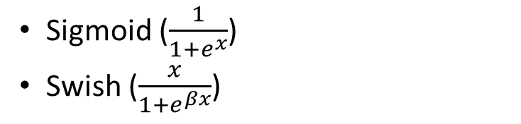
Adding Complexity
Use non-linear activation functions after matrix multiplications to get more complexity
Matrix multiplication
$$∑$$
Signals from other neurons
Neuron Output
Activation function
Common activation functions
ReLU (x = {x if x >0 else 0}
Hyperbolic tangent (tanh)
Sigmoid ($\frac{1}{1+e^{x}}$)
Swish ($\frac{x}{1+e^{βx}}$)
Notes:
As get more experience, threshold changes and the neuron fires more or less depending on whether outcome was good

Slide 13
Measuring Performance
To evaluate how well NN performs, need some kind of metric: a loss function
Measures “distance” from NN output and correct output
Prefer a convex loss function for global minimum
Makes learning easier

Slide 14
How Does Machine Learning Work?
Supervised ML training cycle
Run data with known results through model
Compare with actual values and find the loss
Update model parameters to make loss smaller
Repeat 1-3 until loss no longer gets better
For neural networks, parameters are the weights
Run data through network with current weights
Calculate the loss between network output and actual
Update Weights

Slide 15


Learning
Want to minimize loss -> find the minimum of the loss function
Follow the slope of the curve to the minimum
Slope = gradient of the loss w.r.t. the weights
$$Loss$$
$$θ$$

Slide 16
Learning
In reality, loss functions are often very complicated and full of local minima
Need to set a step size to avoid/get out of local minima and find the global min – learning rate

Slide 17
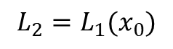
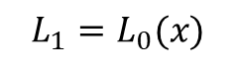
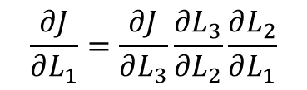
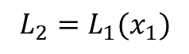

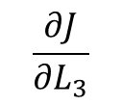
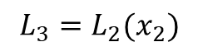

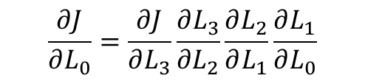

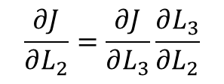

Backpropagation
Calculate the gradient for learning using chain rule
Neural network frameworks will do this for you
Backpropagation
$$\frac{∂J}{∂L_{0}}=\frac{∂J}{∂L_{3}}\frac{∂L_{3}}{{∂L}_{2}}\frac{∂L_{2}}{∂L_{1}}\frac{∂L_{1}}{∂L_{0}}$$
$$\frac{∂J}{∂L_{1}}=\frac{∂J}{∂L_{3}}\frac{∂L_{3}}{{∂L}_{2}}\frac{∂L_{2}}{∂L_{1}}$$
$$\frac{∂J}{∂L_{2}}=\frac{∂J}{∂L_{3}}\frac{∂L_{3}}{{∂L}_{2}}$$
$$\frac{∂J}{∂L_{3}}$$
L₀
L₁
L₂
L₃
$$x$$
$$x_{2}$$
$$x_{0}$$
$$x_{1}$$
$$L_{1}=L_{0}(x)$$
$$L_{2}=L_{1}(x_{0})$$
$$L_{2}=L_{1}(x_{1})$$
$$L_{3}=L_{2}(x_{2})$$
Forward Propagation

Slide 18
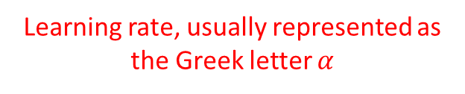
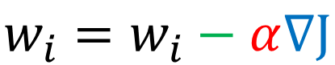
Updating Weights
Once gradient is calculated, take a step in the opposite direction
Often scale this by a constant called a learning rate
This is also usually done by the Python library
Learning rate, usually represented as the Greek letter $α$
$$w_{i}=w_{i}−α∇J$$
Gradient of the loss function at the current node
Weight to be updated
Step in opposite direction of gradient

Slide 19

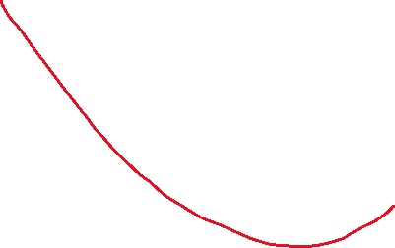
Training and Overfitting
Section data into training, test, and validation sets
Use validation and test data to figure out when network is trained
Ideal Fit
Underfitting
Overfitting
Error
Train
Validate
Test
Validation
Train
Training Iterations

Slide 20
Review
Layers of neurons that approximate some arbitrary function
Mathematically, NN are matrix multiplications sandwiched between nonlinear activation functions
Loss functions measure the performance of a neural network
Training a neural network is finding parameters that have the global minimum loss

Slide 21
Implementation Details
What are we doing today?

Slide 22

MNIST Handwritten Digits
Dataset of pictures of handwritten digits (0-9)
Relatively simple dataset used to learning and research
Provided in PyTorch libraries for easy access
Today’s NN: Take image and predict the digit it represents

Slide 23

PyTorch
A Python-based machine learning framework
Provides loss functions, activation functions, and optimizer algorithms
Calculates gradients for learning with a single call
Dynamically creates neural network computation graphs for easier coding

Slide 24
PyTorch Implementation Details
Conv2D
Custom PyTorch models are classes that inherit from torch.nn.Module and must call the super.__init__() function
Each layer of neurons is a Linear object
Specify the input size and the number of neurons
MaxPool2D
Linear
Linear
Softmax

Slide 25
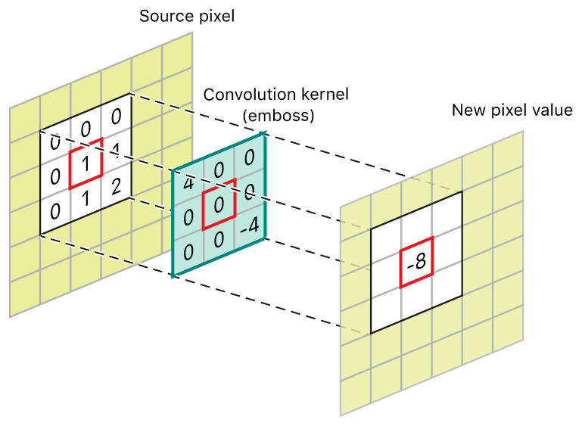
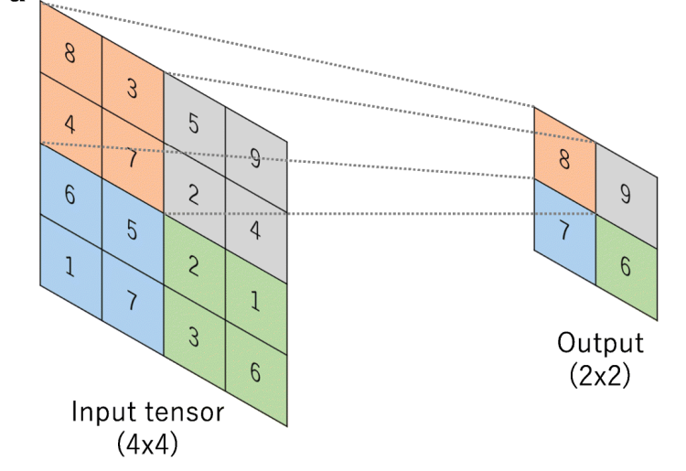
Convolution and Pooling
Convolution moves a kernel of weights over the input
Requires less weights
Pooling moves a kernel over the input and takes either the average or the max of the inputs under it
Downsampling
Requires no trainable weights
Notes:
Convolution – less weights, easier to train, multiple kernels, can use image processing kernels
Pooling – downsampling, less weights down the line

Slide 26



Network Outputs
Soft-
max
$$p_{0}$$
arg
max
0
1
{0, 1, …, 9}
$$p_{1}$$
0
0
.
.
.
For continuous outputs, can have a single node per category
If discrete, is bad because
Imposes implicit ordering
Rounding?
.
.
.
0
0
$$p_{9}$$
0
0
0
For categorical data, want to one-hot encode categories
Often feed through a softmax function and then find the index of largest value

Slide 27
Loss Functions and Optimizers
Can choose different loss functions based on output type
MSE (Euclidean distance) – continuous type
Negative Log-likelihood – categorical probabilities
Frameworks have optimizer classes that take losses and calculate gradients accordingly
Popular optimizer is Stochastic Gradient

Slide 28
Google Colab PyTorch Example
https://colab.research.google.com/drive/1GFFJL_0vMLgaQNNyhYWsUiWFUYzCxkng?usp=sharing

Slide 29
Miscellaneous Cool Stuff

Slide 30
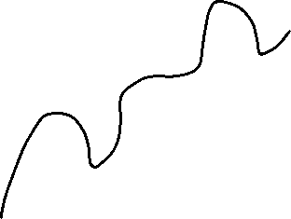
Model Complexity
Given two possible approximations, which one is better?
Which one is easier to train?

Slide 31
Bias-Variance Tradeoff
Theoretical framework for choosing machine learning models
Want to choose a model somewhere in the middle
Optimum Complexity
Total Error
Error
Variance
Bias
Model Complexity

Slide 32
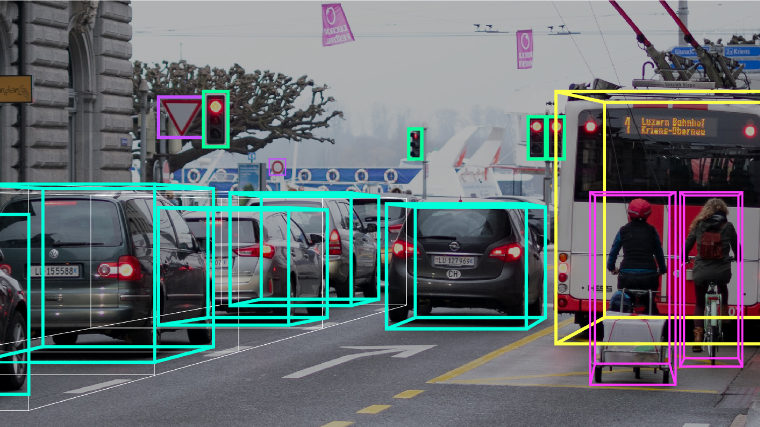
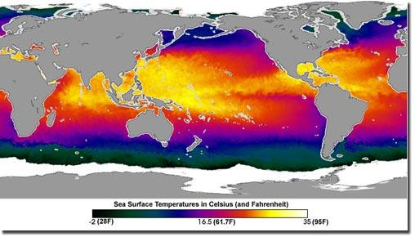
Interesting Discriminative Applications
Image Recognition, drawing bounding boxes, physics code, power hardware implementations
a.k.a. any function possible really

Slide 33
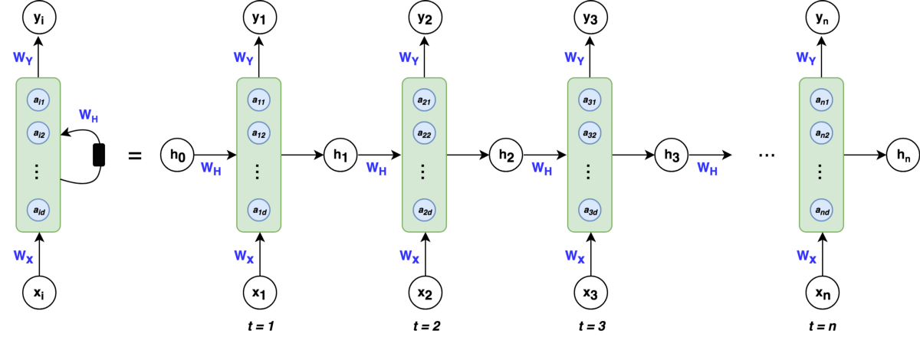
Natural Language Processing
Language is usually represented as a time series, the next word is dependent on the words before it.
Recurrent Neural Networks, LSTMs

Slide 34
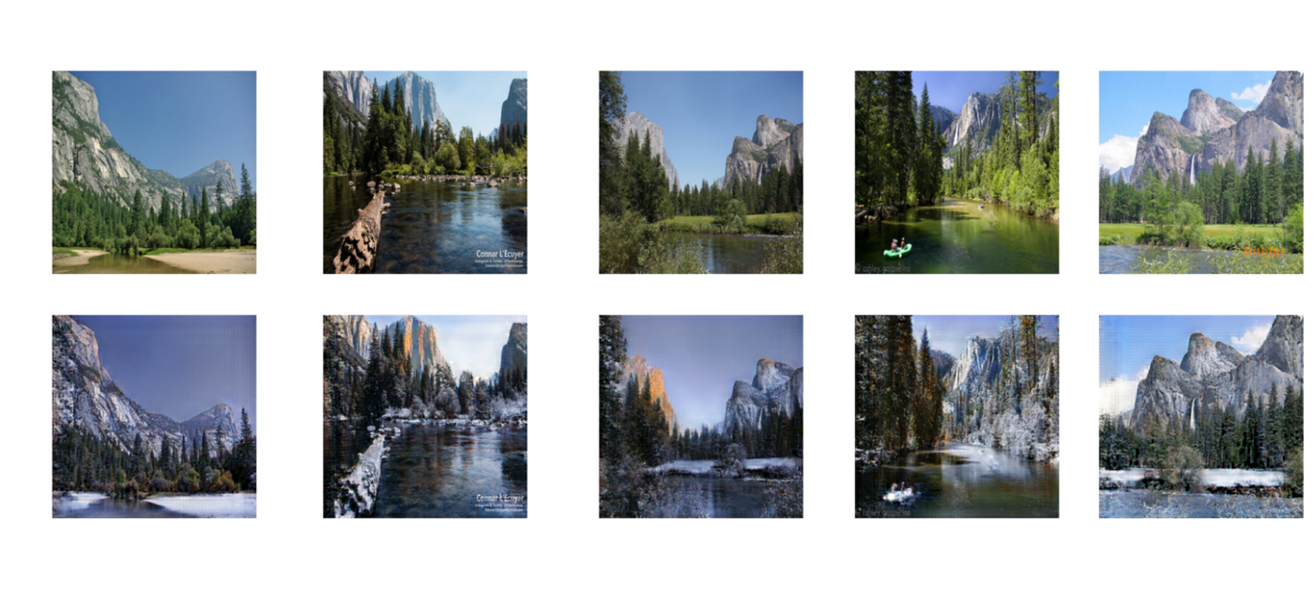
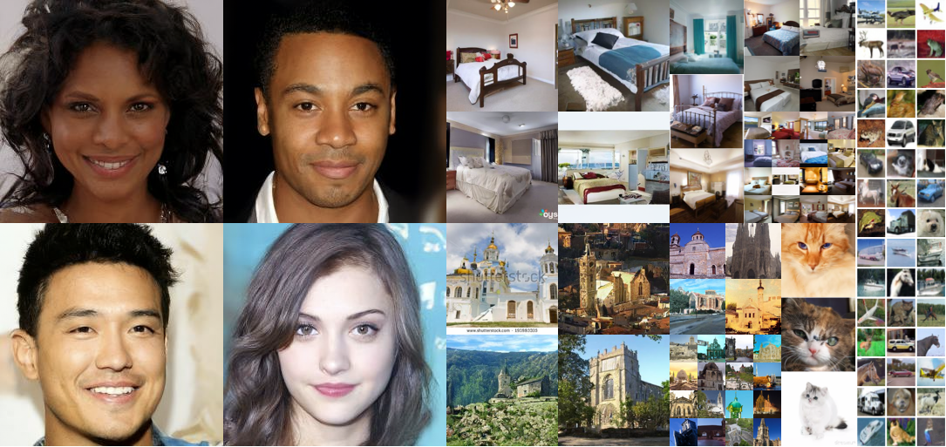
Generative Models
Instead of assigning labels (discriminating), want to make new data (generating)
Variational Autoencoders, Generative Adversarial Networks, Diffusion Models

Slide 35
Resources
See github

